Slide 1
I.N.V.E.S.T. in User Stories

Slide 2
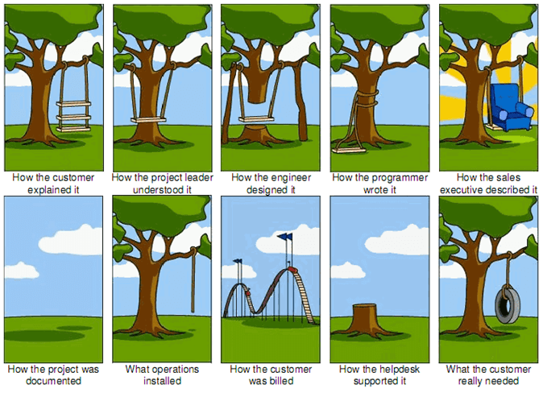
Problem
Tamingdata.com

Slide 3

Problems with “traditional” project requirements
Problem
Communication between stakeholders teams: Business, IT, Infrastructure, Testing, Support.
Estimates for development with too many unknowns.
Commit to deliver to a schedule with too many unknowns.
Focuses on the plan not the “reality”.
Changing requirements over development lifecycle.
Resource allocation, shared resources.
Delivering software (or other business process/project) that is either outdated or doesn’t look/behave the way the stakeholders envisioned.
Managing to assumptions, risks and issues.

Slide 4
How Can Agile help?
Solution
Make decisions about what we know now – Move forward and learn
Prioritize features by highest value-add to the organization/users.
Deliver working features (value) to your business stakeholders more frequently.
Focus on planning instead of the plan.
Most people don’t plan to fail – they fail to plan!
Encourages change and improvement as we learn.
Ferrets out issues EARLY and Solves issues quickly.

Slide 5
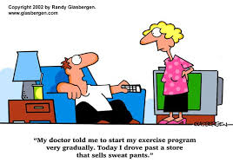
Team Exercise

Slide 6
Definitions
Product Backlog
Used to prioritize features identified by the customer.
Estimated in story points.
Three types of items fit in a backlog:
User stories (a.k.a. new features) – Value adding stories that will enhance the way your customer’s product functions.
Defects – Problems found by development, testing and end users.
Technical debt – Technology changes, prototyping feasibility, and expectations of performance and scalability.
Living document
Backlog grooming – Giving regular care and attention to the product backlog; clean-up outdated or no longer wanted features.

Slide 7
User Stories
Definitions
Are the foundation of your product backlog. With the addition of conversation and acceptance criteria you have the formula to create an effective user story.
Stories are understandable, achievable within a short timeframe.
Written by the team.
Discussed by the team.
Support and encourage iterative development.
Acceptance Criteria
Is written when everyone has a common understanding of the user stories. Provides the conditions of satisfaction associated to the user story.
It answers the question: “How will we know when it does what it should do?” OR “How will we know when we are done?”

Slide 8
Epics
Definitions
A large user story that awaits decomposition into smaller stories prior to implementation.
Typically far off in the development schedule.
Way to organize large groupings of “like-requirements”.
Sometimes used to organize low priority items.
Must be decomposed into smaller stories before sizing.
Themes
A collection of related user stories. i.e. for an online airline reservation system there may be themes of account management, reservations, flight changes/cancellations, and financial processing.
Typically used to organize stories into releases.
Can be used to organize so subteams can work them.

Slide 9
User Stories
User Stories
Prioritized in the backlog by business value.
Sometimes called “Placeholders”.
Not complete requirements.
Encourages conversations.
Generate common understanding.
Determine what needs to be done.
Agreement on the definition of “done”.
Grouped by theme to create flexibility in sprint planning.
Negotiable.
Understood by the whole team.

Slide 10
Acceptance Criteria
Acceptance Criteria
Definition of ‘DONE’.
Comes after a common understanding of the user story is reached.
Product owner should write the acceptance criteria.
A generated list of pass/fail tests.
If all tests pass → everyone agrees the story is implemented as intended.
Does not change during a sprint.
Notes:
Acceptance Criteria does not change during a sprint.

Slide 11
User Story Format
Format
Who: As a <type of user>
What/Functionality: I want <to do something>
Why: So that <so value is created>
As an Airline Customer I want the ability to purchase airplane tickets online, so that I do not have to call into the 800#.
Variations
Goal Focused: In order to <achieve some goal> as a <type of user> I want <to do something>.
Value Focused: In order to <create some value> as a <type of user> I want <to do something>.

Slide 12
INVEST
User Story Best Practices
When writing user stories, keep in mind that these are characteristics of good user stories:
I – Independent: easiest to work with; implement in any order.
N – Negotiable…and Negotiated: story captures the essence not the requirements; it is co-created by the team and the “solve” is negotiated; additional notes, test ideas are included later as the discussion evolves.
V – Valuable: must have value to the customer; delivered to the customer “production ready” including presentation layer, database layer, infrastructure layer, tested and ready to implement.
E – Estimable: story has to be estimated; must be understood to estimate; story can be given a priority with an estimate.
S – Small: the “size” of the work fits into the “size” of the sprint.
T – Testable: characteristic of a good requirement; clear acceptance criteria required to know when “done” and what to test.

Slide 13
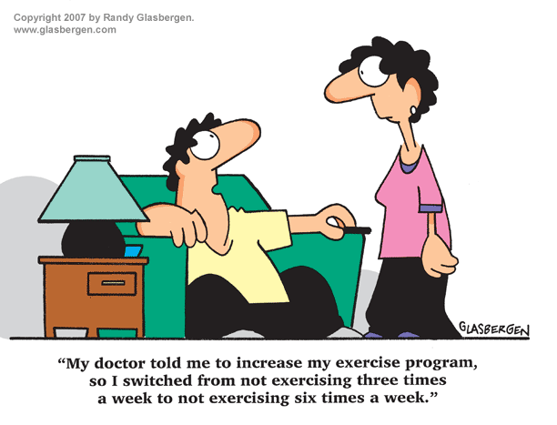
Team Exercise

Slide 14
SMART Tasks
User Story Best Practices
Tasks are the breakdown of the user story. When creating a task plan apply the SMART acronym to improve your tasks.
Tasks are usually created by the person doing the work at the beginning of the Sprint in which they will complete it.
S – Specific: a task that is understood and clear.
M – Measurable: functions as intended; testable.
A – Achievable: the task can be achieved in the time allotted.
R – Relevant: contributes to the user story; explainable to the customer.
T – Time-boxed: limited to a specific duration.

Slide 15
Takeaways
User Stories – add value
Could be decomposed from Epics
Can be grouped by theme
Have a Business Value, Priority and maybe a Rank
Must be understood by the whole team
Housed in the product backlog
Acceptance Criteria
Definition of DONE
Contract with our Users
Do not change during a sprint
Changes require a new User Story
Additional reading: User Stories Applied by Mike Cohn

Slide 16
Business Value, Priority & Rank
Business Value is the relative weight or impact an item will have on the business or end user. The more positive the impact is if an item is delivered, the higher the Business Value.
Priority is the importance of the item to the end user to having a functional system or feature. Helps determine order in which to deliver to ensure we delivery highest priority work first.
Rank is the specific order in which each item should be worked. There is one and only one #1, one and only one #2, etc.

Slide 17
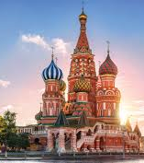
MoSCoW
Prioritization
Must Have
Should Have
Could Have
Would Like

Slide 18
Story Prioritization
Must Have
Non-negotiable.
There is no “product” without the item
All Must Haves = Minimally Viable Product
Should Have
Really is not complete without
If absolutely necessary we can push it off until later
Could Have
Is not important
Could take it or leave it
Would Like*
Bell and Whistle
Nice to have
Often what “makes” the user experience

Slide 19
Story Prioritization
Product Owner
Prioritizes all work items
May act as a “benevolent dictator”
Seeks input from business area subject matter experts
Is influenced by team’s estimation of Level of Effort/Story Points of work item

